Slide 1
Virtual Private Cloud and Load Balancers
Leonidas Kontothanassis

Slide 2
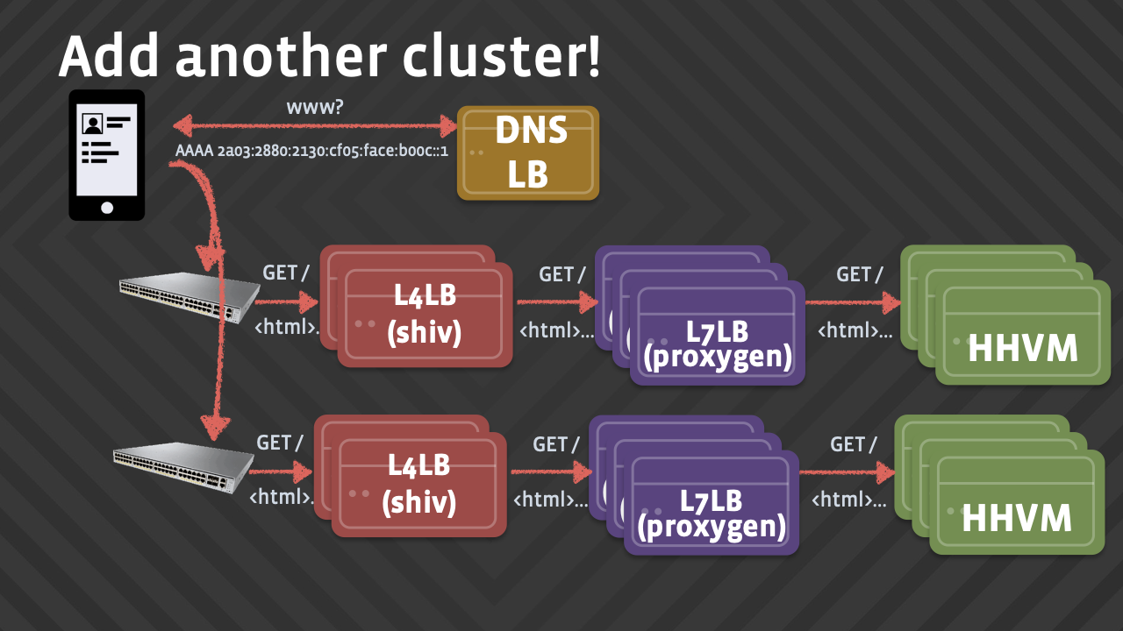
Load Balancers
What are they good for?
Distribute requests to backends that process them based on their health, their load and sometimes other characteristics (data affinity, request state, regulatory considerations, etc.)
Cache
L3 LB
L3 LB

Slide 3
Load Balancers on GCP
Two kinds
Network Load Balancer
HTTP Load Balancer

Slide 4
Load Balancers on GCP
 | Network | HTTP
Traffic Type | Any IP traffic | HTTP only
Complexity | Low | High
Deployment | Regional | Global
Balancing Ability | Coarse | Fine

Slide 5
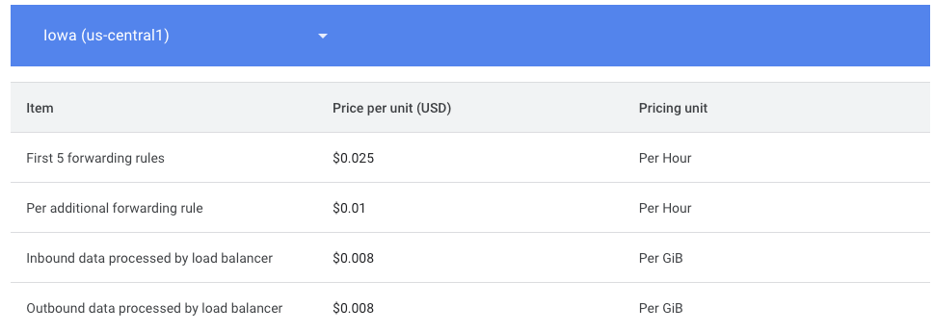
Load Balancer Pricing
Load balancer costs
Egress costs
https://cloud.google.com/vpc/network-pricing#lb

Slide 6
Network Load Balancer Flow
Create the backend instances
Create/update firewall rules for those instances
Create the load balancing service
Create load balancer
Configure backends
Configure health checks
Configure forwarding rule
Send traffic!

Slide 7
Create Backend Instances
First create 2-3 VM instances that will run your backend server (See below example for command line)
gcloud compute instances create www1 \
--zone=us-south1-b \ --tags=my-lb \
--machine-type=e2-micro \
--image-family=debian-12 \
--image-project=debian-cloud \
--metadata=startup-script='#!/bin/bash
apt-get update
apt-get install apache2 -y
service apache2 restart
echo "<h3>Web Server: www1</h3>" | tee /var/www/html/index.html'
Make sure to replace the zone and tag with one that makes sense for you.

Slide 8
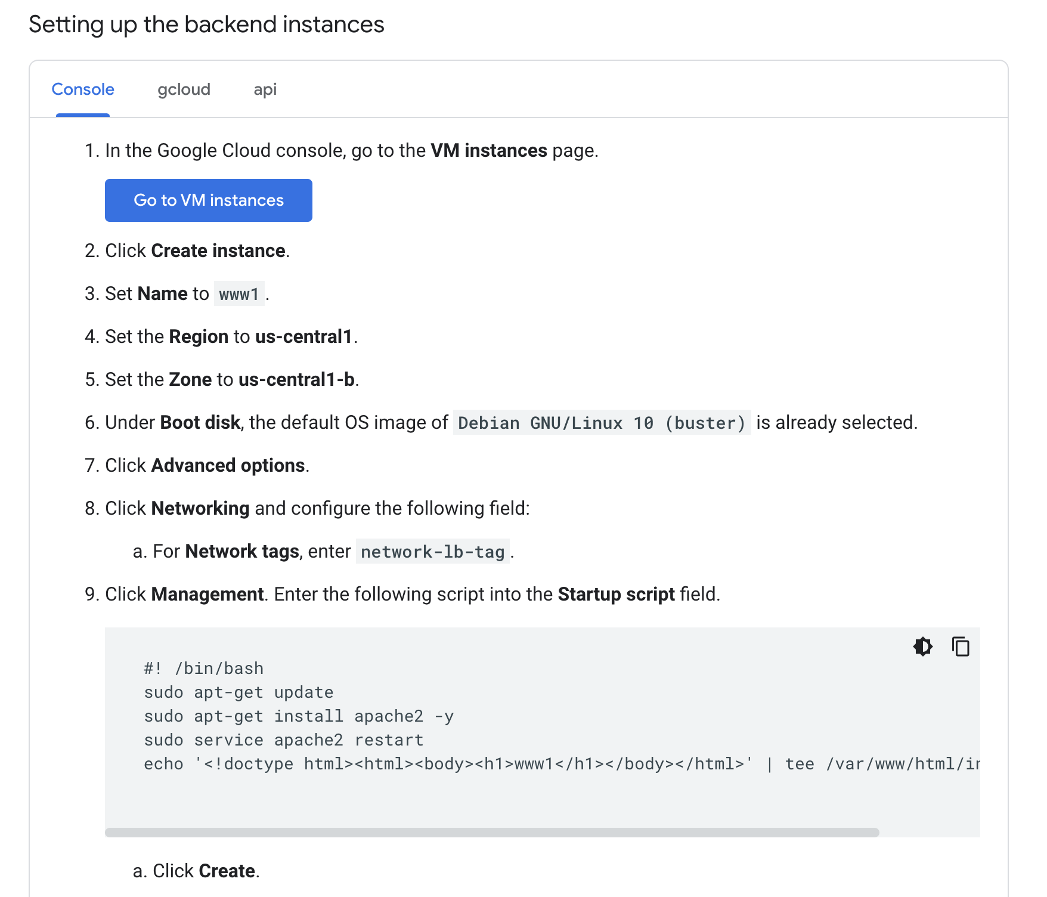
Create Backend Instances
Or use the console

Slide 9
Create Firewall Rules
# Create the firewall and set its TAG to the TAG of the instances you created earlier
gcloud compute firewall-rules create www-firewall-network-lb \
--target-tags my-lb --allow tcp:80
gcloud compute instances list (Get the IP addresses and see if they work)

Slide 10
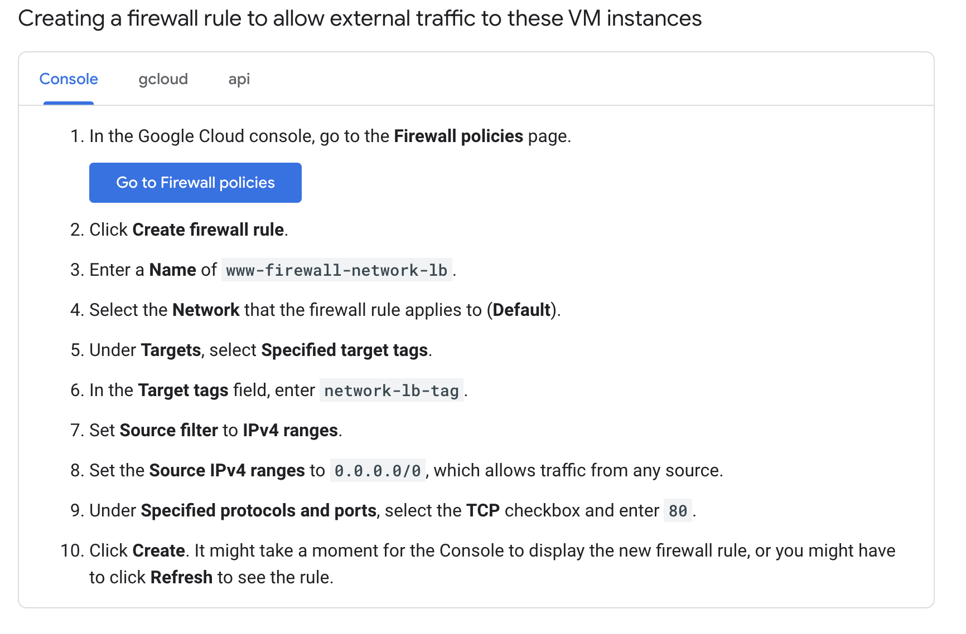
Create Firewall Rules
Or use the console

Slide 11
Firewall Rules vs Policies
Firewall Rules
https://cloud.google.com/firewall/docs/firewalls#firewall_rule_components
Direction, priority, action, enforcement, target tag, source or destination filter, protocol, logging
Firewall policies
https://cloud.google.com/firewall/docs/firewall-policies-overview
Groups of rules applies to orgs, projects, subnets or other larger entities (not just tagged objects)’
Firewall configuration
Notes:
What is the relationship between DoS and Firewalls?

Slide 12
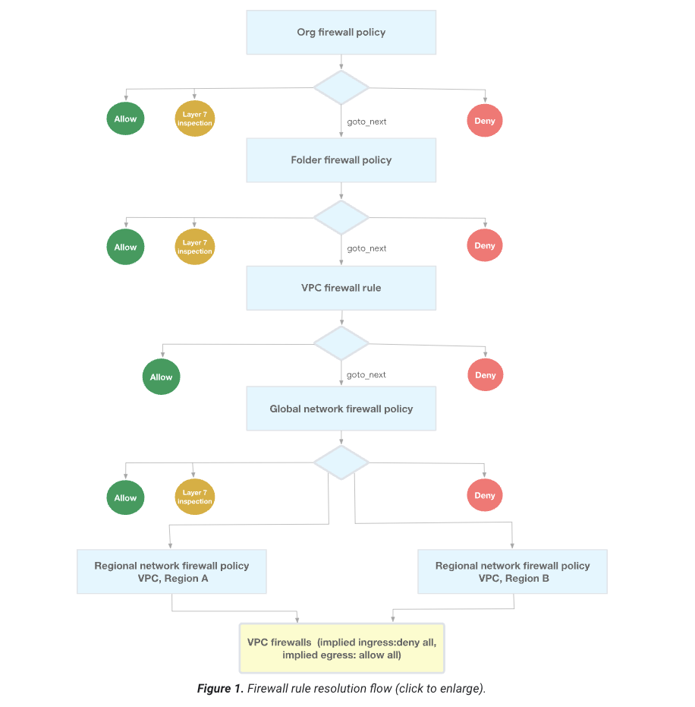
Firewall rules and policy order

Slide 13
Create load balancer
gcloud compute addresses create network-lb-ip-1 --region us-south1 (Configure the network load balancer)
gcloud compute http-health-checks create basic-check (Health checker created, this one does nothing let’s check the documentation and documentation)
gcloud compute target-pools create www-pool \
--region us-south1 --http-health-check basic-check (Create a pool that the healthchecker will check)
gcloud compute target-pools add-instances www-pool \
--instances www1,www2,www3 --instances-zone=us-south1-b (Add your instances to the pool)
gcloud compute forwarding-rules create www-rule \
--region us-south1 \
--ports 80 \
--address network-lb-ip-1 \
--target-pool www-pool (Add a forwarding rule telling the load balancer to forward to the instances, if they are healthy)
gcloud compute forwarding-rules describe www-rule --region us-south1 (Find the external IP of your load balancer)
IPADDRESS=$(gcloud compute forwarding-rules describe www-rule --region us-south1 --format="json" | jq -r .IPAddress) (Extract the IP address from the previous command)
while true; do curl -m1 $IPADDRESS ; sleep 1; done (Send requests to the load balancer and see who responds).
Notes:
When creating the network-lb address you can specify --addresses to make it a reserved IP address though it’s not that big of a benefit. In the demo show what happens when a VM is stopped and restarted.
Then show what healthchecks look like. Explain that healthchecks expect a 200 response to consider something healthy. Corner case is when all backends are unhealthy. Loadbalancer assumes all are healthy.

Slide 14
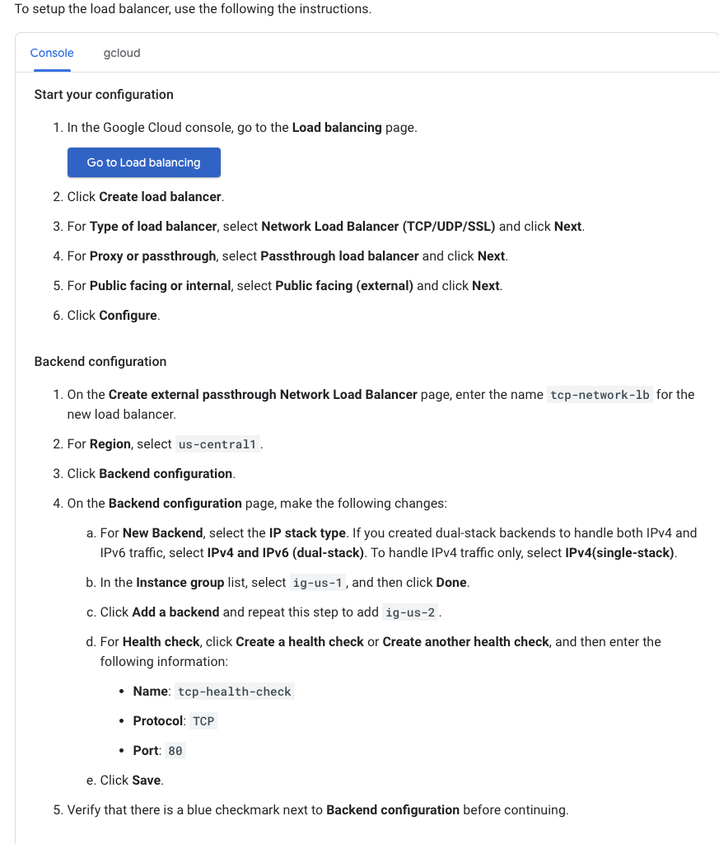
Create Load Balancer
Or use the console

Slide 15
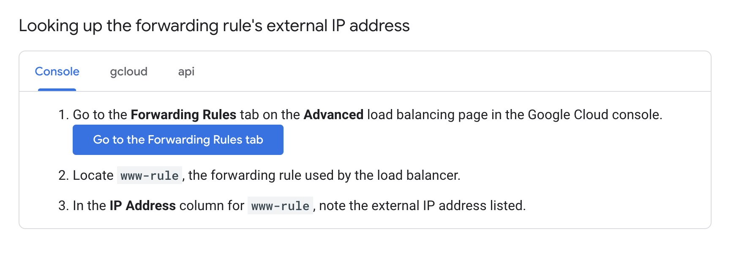
Create Load Balancer #2
Or use the console

Slide 16
Cleaning up
gcloud compute forwarding-rules delete www-rule --region us-south1
gcloud compute target-pools delete www-pool --region us-south1
gcloud compute http-health-checks delete basic-check
gcloud compute addresses delete network-lb-ip-1 --region us-south1
gcloud compute instances delete www1 --zone=us-south1-b
gcloud compute instances delete www2 --zone=us-south1-b
gcloud compute instances delete www3 --zone=us-south1-b
gcloud compute firewall-rules delete www-firewall-network-lb

Slide 17
Network Load Balancer
Non-pool based option (currently preferred option but more complicated)
Multiple protocols
Logging and Monitoring

Slide 18
Load Balancer Address Translation
Clients connect to load balancer IP address and expect answers from that IP.
VMs have their own IPs that the load balancer forwards to
On the backend instances that accept load-balanced traffic, you must configure the software to bind to the IP address associated with the load balancer's forwarding rule (or to any IP address, 0.0.0.0/0).
This is known as address spoofing
Notes:
Explain how IP translation works between backend instances and the load balancer. Notice this is a passthrough load balancer with direct response.

Slide 19
HTTP Load Balancer Flow
Create an instance template
Create a backend group based on the template
Create the firewall rules
Create the IP address
Create the health checker
Create a backend service
Associate your instance group with the backend service
Create a url map for the backend service
Create a proxy instance for the url map
Create a forwarding rule to route to the proxy instance

Slide 20
HTTP Load Balancer
gcloud compute instance-templates create lb-backend-template \
--region=REGION \
--network=default \
--subnet=default \
--tags=allow-health-check \
--machine-type=e2-medium \
--image-family=debian-12 \
--image-project=debian-cloud \
--metadata=startup-script='#!/bin/bash
apt-get update
apt-get install apache2 -y
a2ensite default-ssl
a2enmod ssl
vm_hostname="$(curl -H "Metadata-Flavor:Google" \
http://169.254.169.254/computeMetadata/v1/instance/name)"
echo "Page served from: $vm_hostname" | \
tee /var/www/html/index.html
systemctl restart apache2'
#(The command above creates an instancetemplate)

Slide 21
HTTP Load Balancer
gcloud compute instance-groups managed create lb-backend-group \
--template=lb-backend-template --size=2 --zone=us-south1-b
#(Create a backend instance group based on the template)
gcloud compute firewall-rules create fw-allow-health-check \
--network=default \
--action=allow \
--direction=ingress \
--source-ranges=130.211.0.0/22,35.191.0.0/16 \
--target-tags=allow-health-check \
--rules=tcp:80
#(Create a firewall rule)
gcloud compute addresses create lb-ipv4-1 \
--ip-version=IPV4 \
--global
#(Now that you have instances create the IP that will be used to reach the loadbalancer)

Slide 22
HTTP Load Balancer
gcloud compute addresses describe lb-ipv4-1 \
--format="get(address)" \
--global
#(Find the IP)
gcloud compute health-checks create http http-basic-check \
--port 80
#(Create a health checker)
gcloud compute backend-services create web-backend-service \
--protocol=HTTP \
--port-name=http \
--health-checks=http-basic-check \
--global
# (Create a backend service)

Slide 23
HTTP Load Balancer
gcloud compute backend-services add-backend web-backend-service \
--instance-group=lb-backend-group \
--instance-group-zone=us-south1-b \
--global
#(Add your instance group to the backend service)
gcloud compute url-maps create web-map-http \
--default-service web-backend-service
#(Create URL map to map requests to different backend services)
gcloud compute target-http-proxies create http-lb-proxy \
--url-map web-map-http
#(Create a proxy instance that routes requests to the URL map)
gcloud compute forwarding-rules create http-content-rule \
--address=lb-ipv4-1\
--global \
--target-http-proxy=http-lb-proxy \
--ports=80
#(Create a forwarding rule to route requests to the proxy)

Slide 24
HTTP Load Balancer
Use the console to make one:
https://cloud.google.com/load-balancing/docs/https/ext-https-lb-simple

Slide 25

Virtual Private Cloud (VPC)
Provide network functionality to your cloud deployments
Key concepts
Subnets
Routes
Firewalls
Internal load balancing
Default Network

Slide 26
VPC Networking
Subnets
Parts of the network that have their own unique IP address range.
Different regions must belong to different subnets
Routes
Rules that specify how to route traffic from one subnet to another
Firewalls
Rules that specify what traffic is allowed to enter and leave each subnet
Internal load balancing
Similar to what we have seen but for internal traffic
Default Network
What you start with when you create a project. It creates a subnet for every region you have resources in.

Slide 27
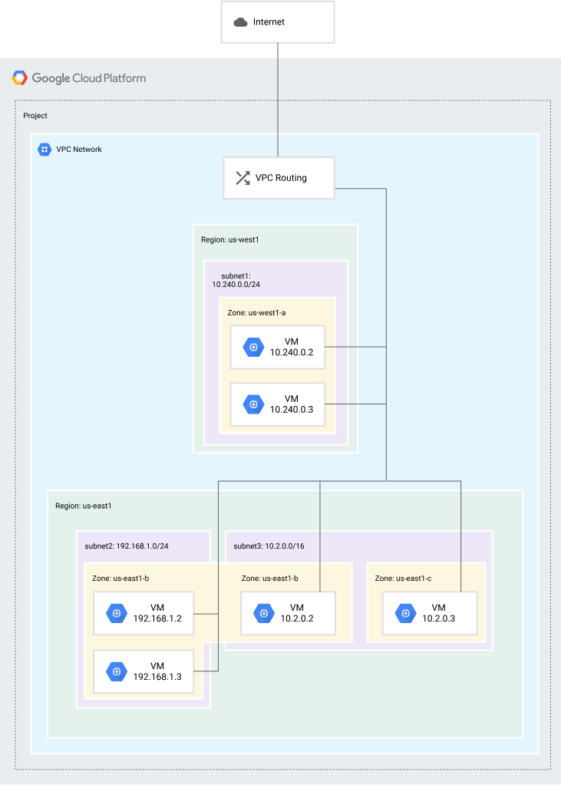
VPC Example

Slide 28
VPC Networking
Why bother?
Engineering subnet shouldn’t talk to HR subnet?
Legal subnet should not talk to engineering subnet?
Executives should have access to all subnets?
Employees should have access to some assets in HR but not all?
….

Slide 29
VPC Networking Tutorial
Tutorial

Slide 30
Attendance poll
https://piazza.com/class/mkctevprups13o/post/161
For next lecture read Andromeda paper
https://www.usenix.org/system/files/conference/nsdi18/nsdi18-dalton.pdf

